Slide 1
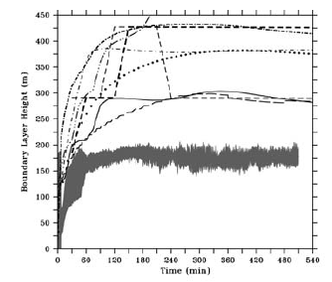
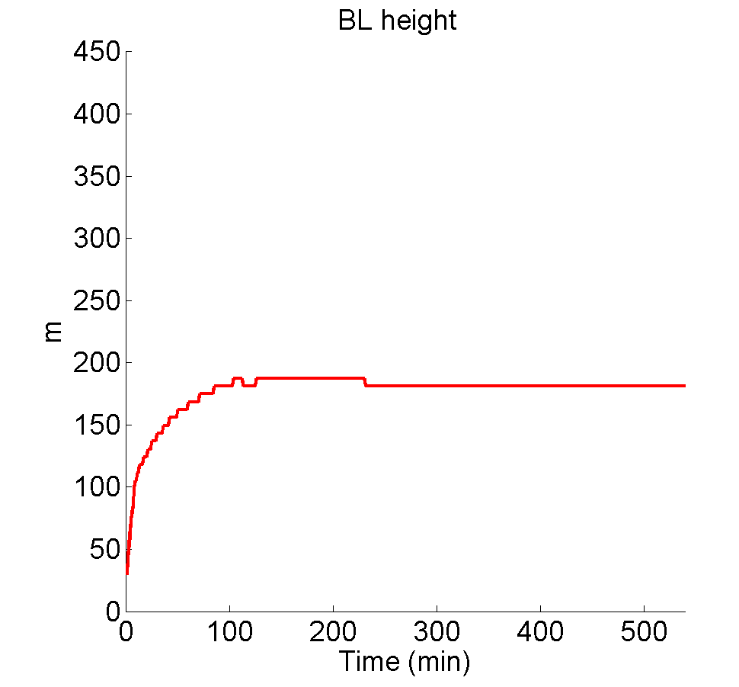
Boundary layer height, m

Slide 2
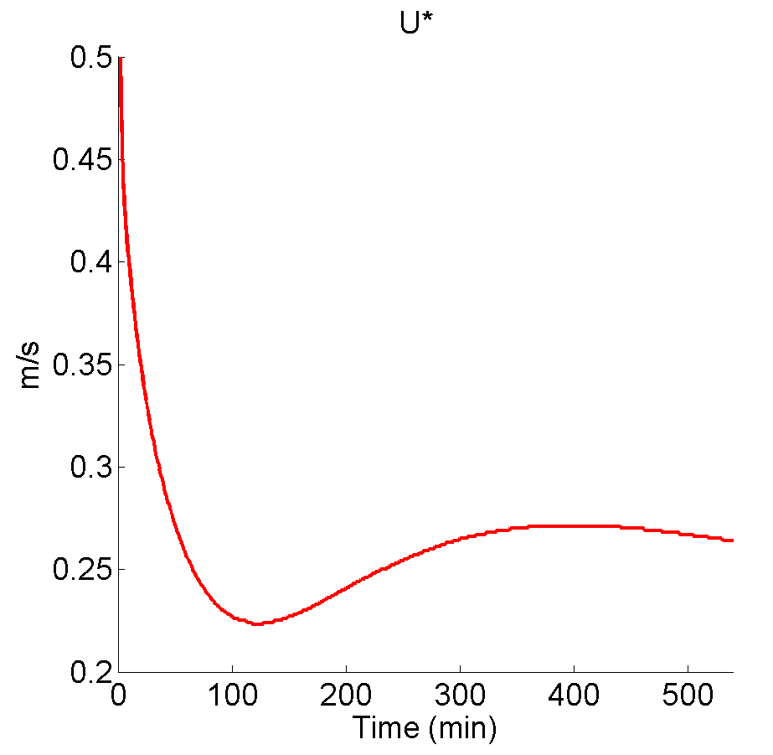
Friction velocity u*, m/s

Slide 3
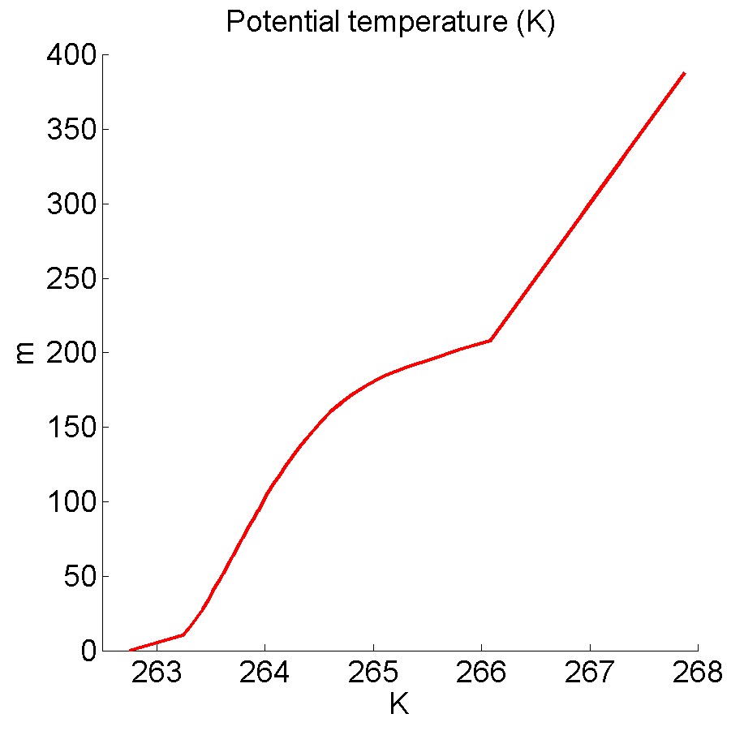
Vertical profiles of potential temperature, K

Slide 4
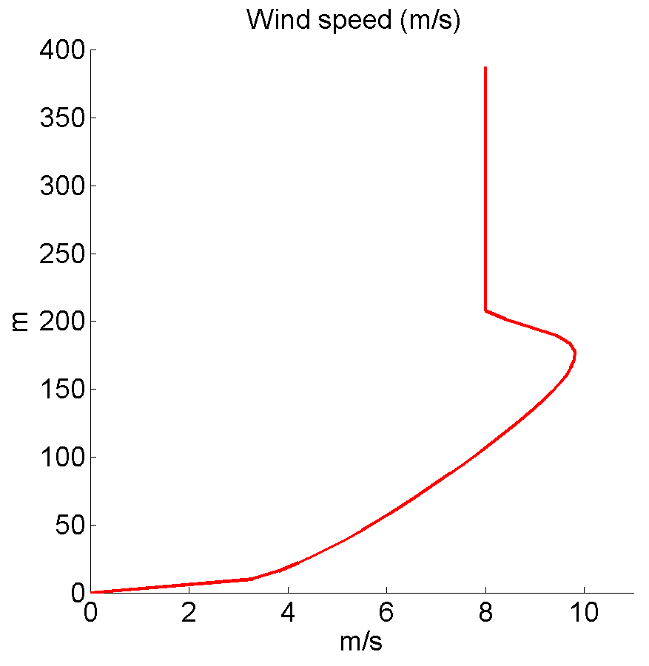
Vertical profiles of wind speed, m/s

Slide 5
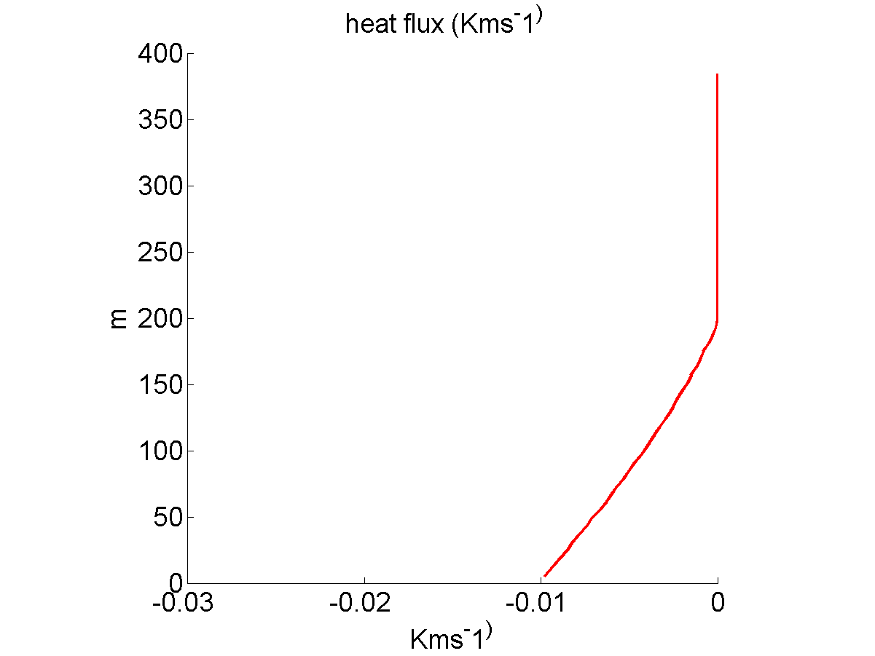
Vertical profiles of heat flux, Kms⁻¹

Slide 6
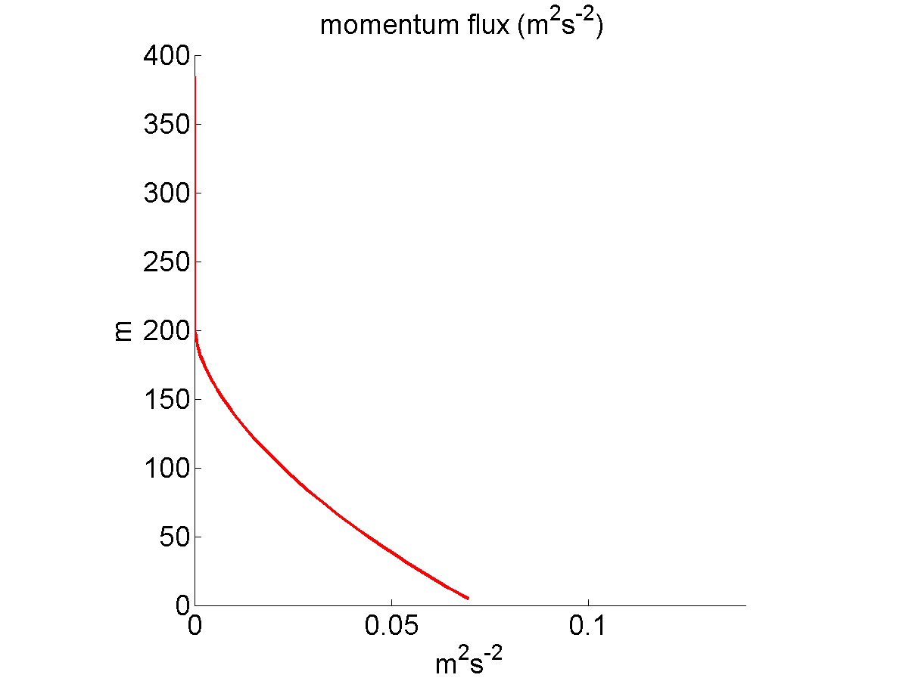
Vertical profiles of momentum flux, m²s⁻²

